Slide 1
Image-Based Situation Awareness Audit 1.3.2018
Sakari Lampola

Slide 2
Previous Audit 11.1.2018

Slide 3
Open questions:
Role of classical object tracking alrorithms?
What to do with multiple bounding boxes around one object?
Appropriate minimum confidence level?
What to do with false detections inside other objects?
What to do with false detections from the background?
How to set Kalman filter parameters for image object filtering?
Hungarian algorithms special case for hidden objects
To do:
Close open questions
Image object status
Image object velocity estimation
Probabilistic approach for matching detected and image objects
2d -> 3d transformation
World object state estimation
Other:
Semantic segmentation
Organisations to follow: ICCV, ICRA, NIPS, IROS, arXiv
Camera motion (yaw, pitch)
Grid or continuos presentation?
Class specific attributes
Object history
Previous Audit

Slide 4
Project Plan

Slide 5
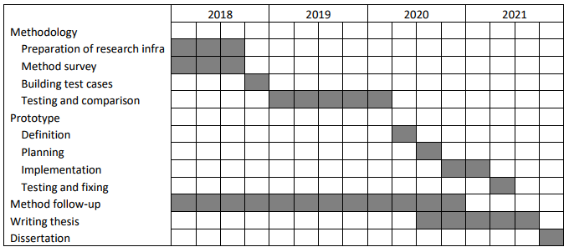
Project Plan
Methodology / Preparation of research infra
Software platforms are constructed and tested
Off-the-shelf models are acquired and tested
Necessary skills on platforms are learned
Methodology / Method survey
Current state-of-art methods are studied
Methods are constructed and tested on the software platforms
Method follow-up
Screening of conference papers related to the subject
Possibly integrating new methods to the project

Slide 6
Work Done

Slide 7
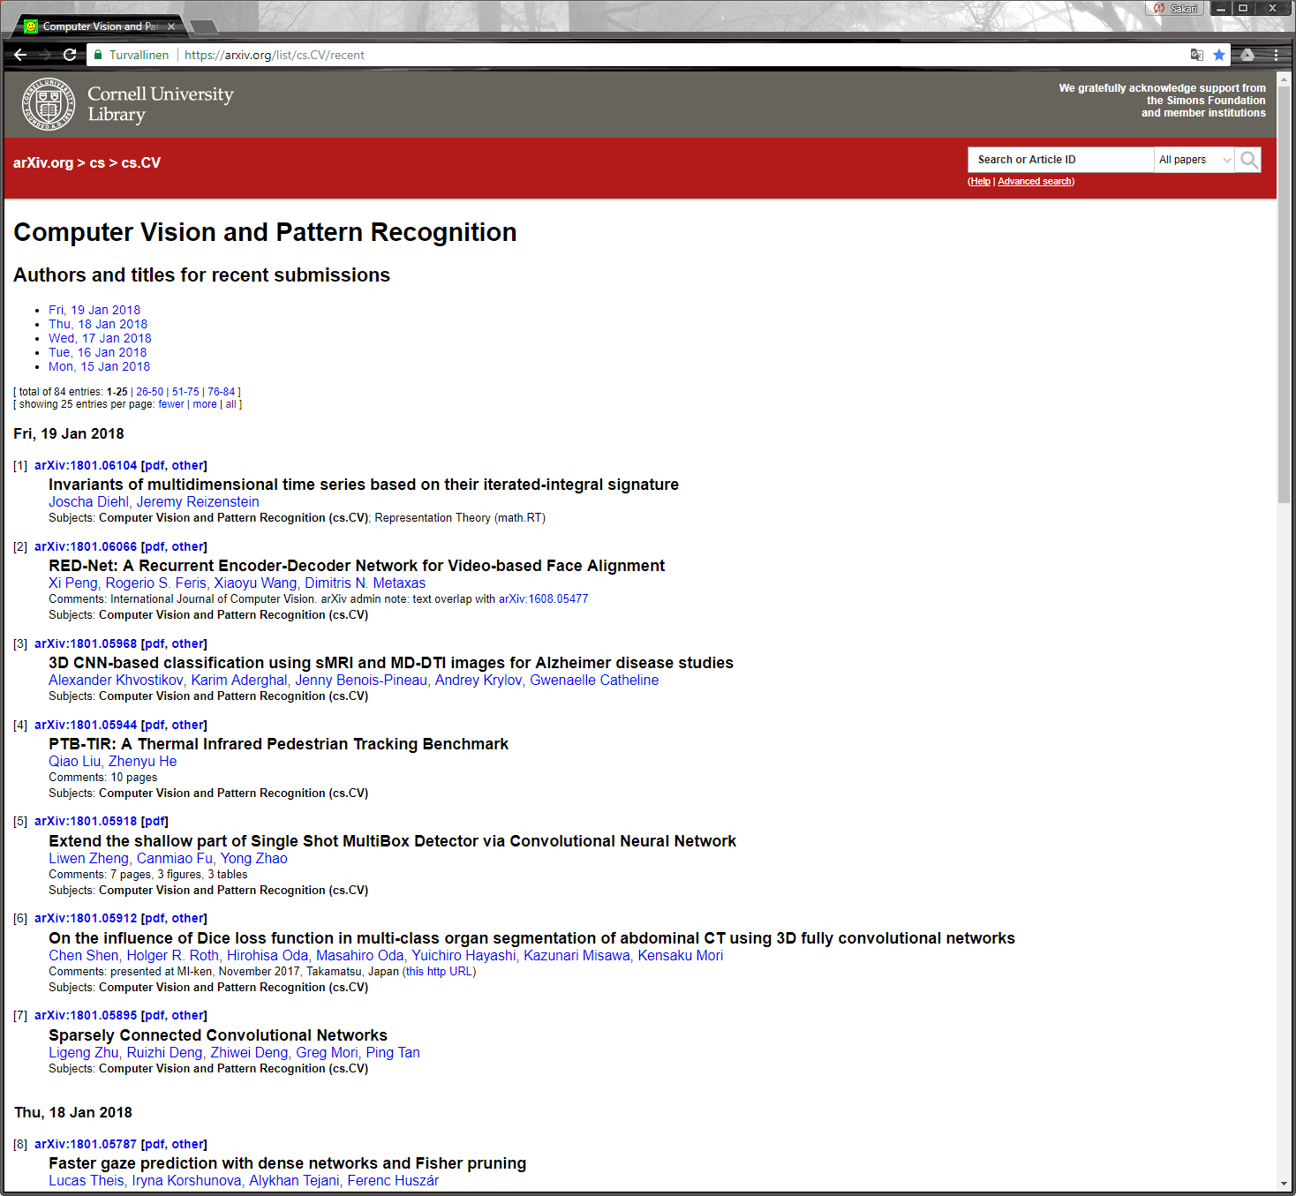

Method Follow-Up

Slide 8
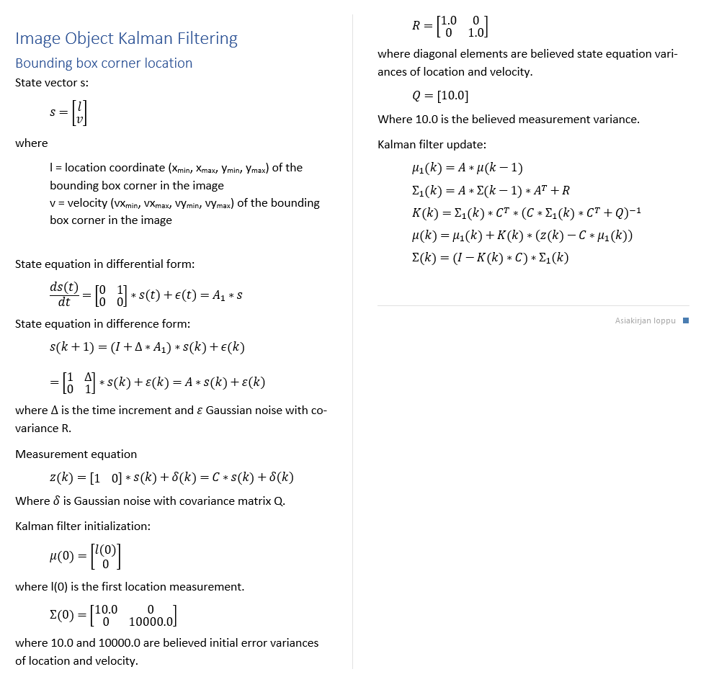
Image object velocity is necessary for:
predicting image object locations when matching new measurements
identifying image objects
predicting image object locations for hidden objects
Image object
id
status
x_min
x_max
y_min
y_max
vx_min
vx_max
vy_min
vy_max
class
confidence
appearance
Image Object Velocity Estimation
Estimation algorithm
Numerical values are estimated using grid search and 10 step ahead
mean prediction error. Values rounded. Later adjusted by experiments.

Slide 9
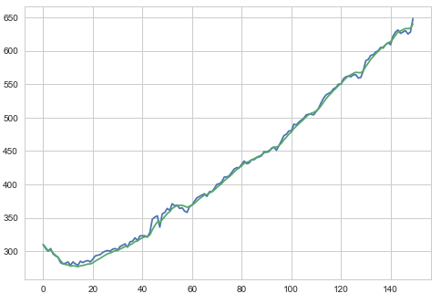
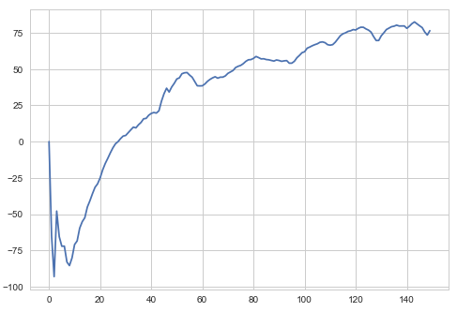
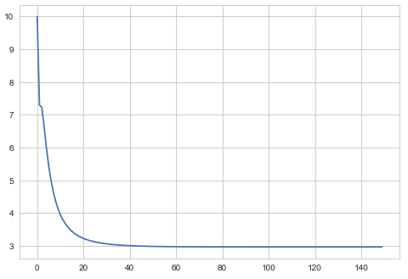
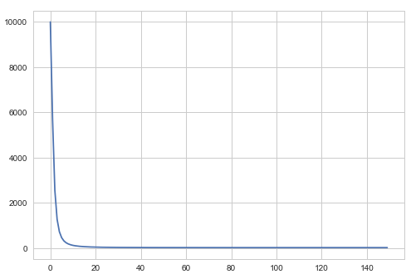
Moving object (car)
Image Object Velocity Estimation
Measured and filtered location (upper left corner)
Estimated velocity
Location variance
Velocity variance

Slide 10
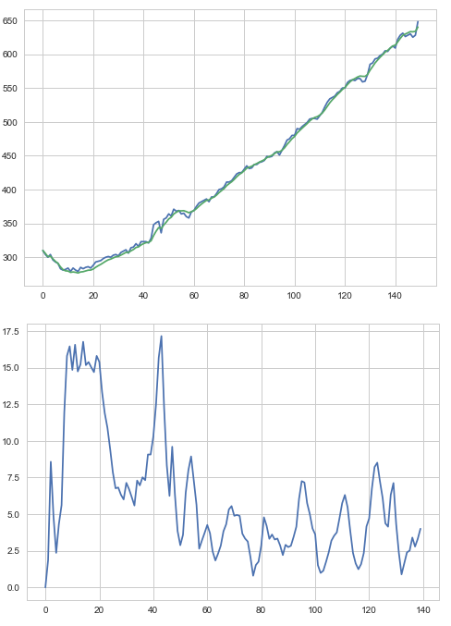
Moving object (car)
Image Object Velocity Estimation
10 step ahead mean prediction error

Slide 11
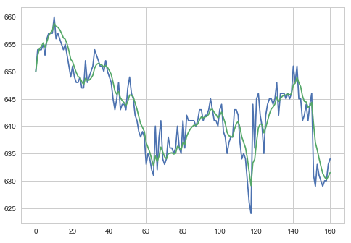
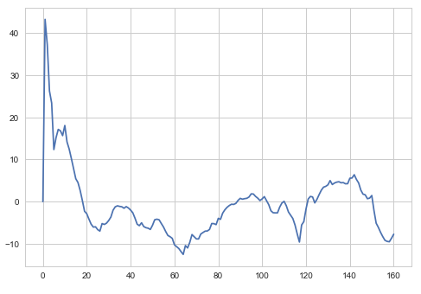
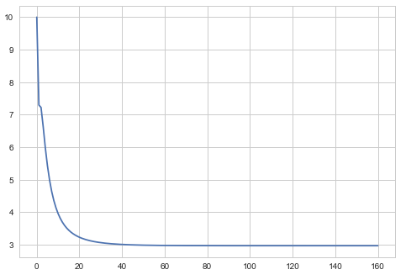
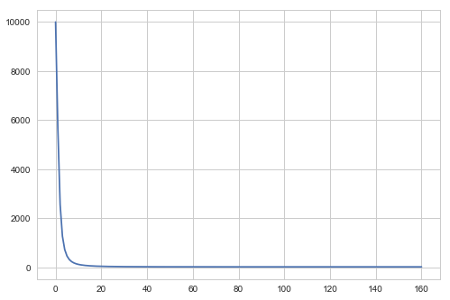
Static object (calf)
Image Object Velocity Estimation
Measured and filtered location (upper left corner)
Estimated velocity
Location variance
Velocity variance

Slide 12
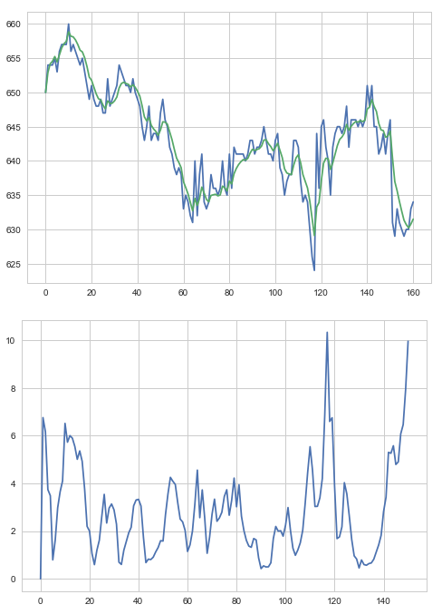
Static object (calf)
Image Object Velocity Estimation
10 step ahead mean prediction error

Slide 13
Software Architecture
Speech Synthesis
Video file
Camera
OpenCV
AnalyzeVideo
ObjectDetection
Speakers
ImageClasses
MobileNetSSD (caffe)
pyttsx3
SpeechSynthesis

Slide 14
Entities
Speech Synthesis
Image World
Image Object
Event
Event
time
text
priority
Event is generated when
new image object is created
image object status is changed
Event will pause the video for the duration of speech (not in the final version)
Events are collected (history)

Slide 15
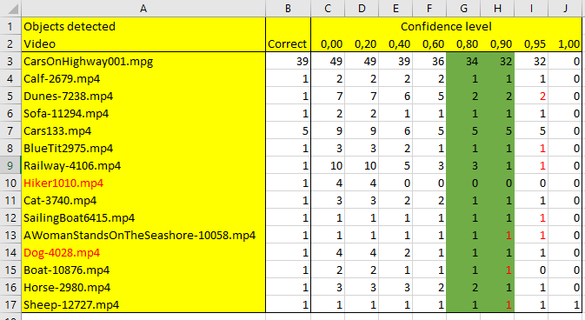
SSD Mobilenet implementation:
# extract the confidence (i.e., probability) associated with the prediction
Confidence Level
Good value for creating a new image object is between 0.8 and 0.9.
The ’good’ value also depends on other hyperparameters.

Slide 16
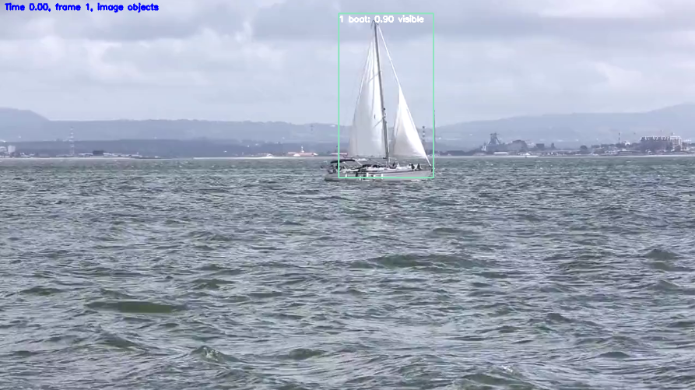
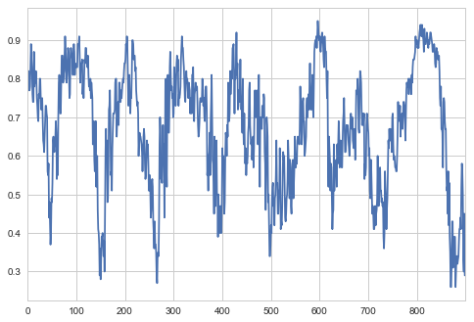
Confidence Level
Confidence level has dynamics
create
Update (not class)
ignore
Different levels for creating and updating image object. Hyperparameters:
CONFIDENCE_LEVEL_CREATE (0.8)
CONFIDENCE_LEVEL_UPDATE (0.2)

Slide 17
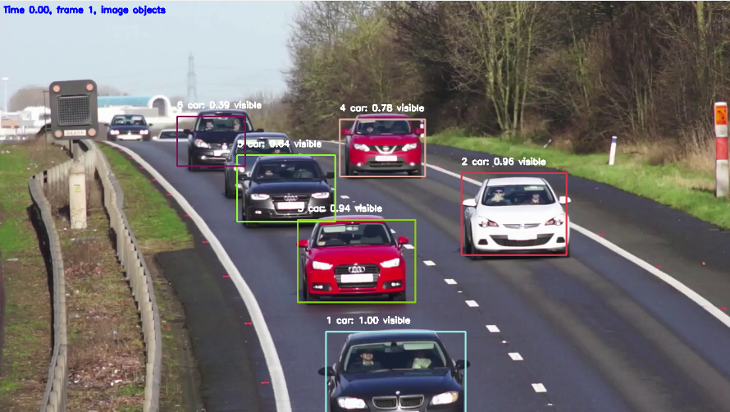
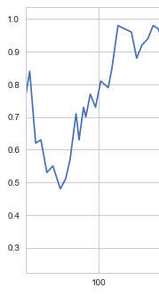
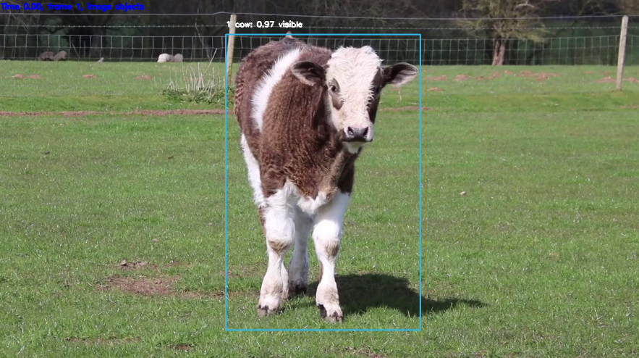
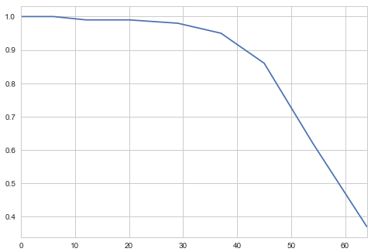
Confidence Level

Slide 18
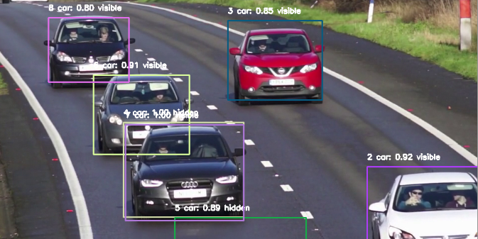
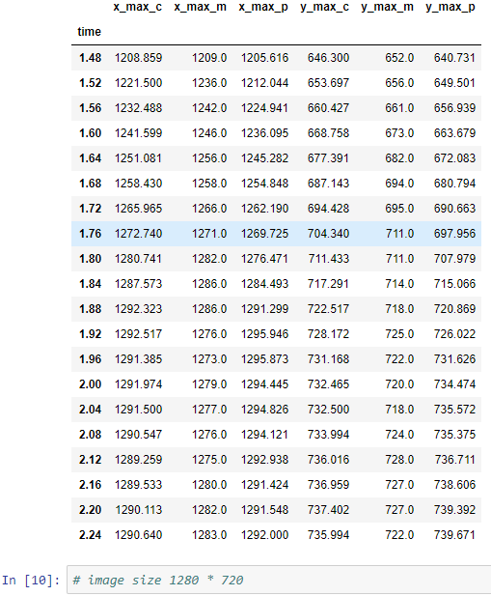
Border Behaviour
Box size and form distorded
Hyperparameter BORDER_WIDTH (30)

Slide 19
Border Behaviour
1
2
3
4
5
6
Type 3 and 5: world object not updated
Type 6: removed, world object acceleration fixed
If an object touches 3 borders, it is removed
Done for:
left
right
top
bottom

Slide 20
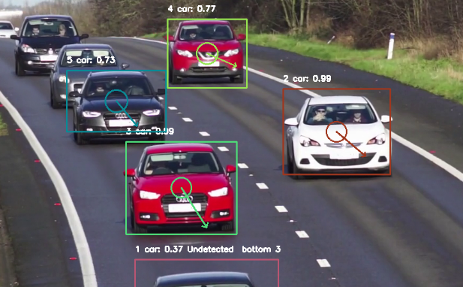
Visual Presentation
Ellipse axes proportional to the standard deviation of the location (2*std, corresponding to 95% probability)
Arrow direction and length proportional to velocity (measured in pixels/second)

Slide 21
Object Retention
Image objects are removed if not detected in RETENTION_COUNT_MAX (30) successive frames.

Slide 22

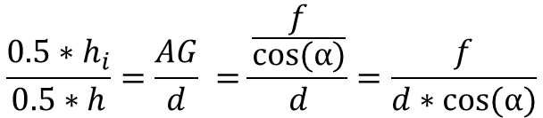
D
Distance Estimation
F
h
E
C
G
h_{i}
AF=d (distance)
A
B
α
f
Similar triangles AGE and AFD:
$$\frac{{0.5∗h}_{i}}{0.5∗h}=\frac{AG}{d} =\frac{\frac{f}{cos⁡(α)}}{d}=\frac{f}{d∗cos⁡(α)}$$
$$d=\frac{f∗h}{{\cos\left(α\right)∗h}_{i}}$$
Simalar equations for horizontal direction
(β=azimuth)

Slide 23
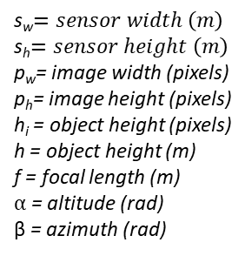


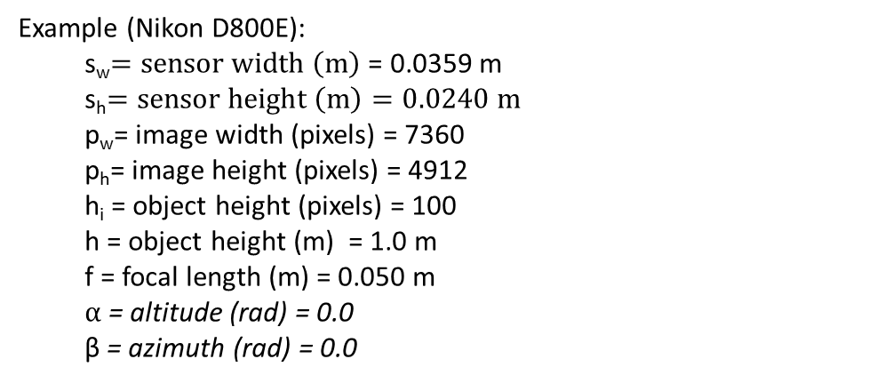
$$d=\frac{f∗h}{{\cos\left(α\right)∗\cos\left(\text{β}\right)∗h}_{i}}=\frac{f∗h}{\cos\left(α\right)∗\cos\left(\text{β}\right)∗\text{h}\text{i}∗\text{s}\text{h}\text{/}\text{p}\text{h}}$$
s_{w}$=sensor width \left(m\right)$
s_{h}$=sensor height \left(m\right)$
p_{w}= image width (pixels)
p_{h}= image height (pixels)
h_{i} = object height (pixels)
h = object height (m)
f = focal length (m)
$α$ = altitude (rad)
β = azimuth (rad)
Distance Estimation
Example (Nikon D800E):
s_{w}$=sensor width \left(m\right)$ = 0.0359 m
s_{h}$=sensor height \left(m\right)=0.0240 m$
p_{w}= image width (pixels) = 7360
p_{h}= image height (pixels) = 4912
h_{i} = object height (pixels) = 100
h = object height (m) = 1.0 m
f = focal length (m) = 0.050 m
$α$ = altitude (rad) = 0.0
β = azimuth (rad) = 0.0
$$d=\frac{0.050m∗1m}{\text{1.0∗1.0∗100}∗\text{0.024}\text{m}\text{/4912}}=102.33 m$$

Slide 24
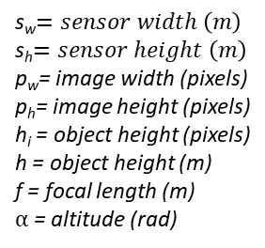




2d -> 3d Transformation
y
x
z
From pixel coordinates (sensor plane) to 3d camera coordinates:
s_{w}$=sensor width \left(m\right)$
s_{h}$=sensor height \left(m\right)$
p_{w}= image width (pixels)
p_{h}= image height (pixels)
h_{i} = object height (pixels)
h = object height (m)
f = focal length (m)
$α$ = altitude (rad)
(x_{c}, y_{c}, z_{c}) = (- $\frac{s_{w}}{2}+xp$* $\frac{s_{w}}{pw}$, $\frac{s_{h}}{2}−yp$* $\frac{s_{h}}{ph}$, -f)
Object center will be on the line:
(x_{o}, y_{o}, z_{o}) = t* (x_{c}, y_{c}, z_{c})
The length of the line is:
$$d=\frac{f∗h}{\cos\left(α\right)∗\cos\left(\text{β}\right)∗\text{h}\text{i}∗\text{s}\text{h}\text{/}\text{p}\text{h}}$$
$α=$ arc tan(y_{c}/f)
$β=$ arc tan(x_{c}/f)

Slide 25
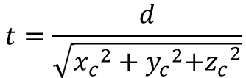

$$t^{2}∗({x_{c}}^{2}+{y_{c}}^{2}{{+z}_{c}}^{2})=d^{2}$$
2d -> 3d Transformation
$$t=\frac{d}{\sqrt{{x_{c}}^{2}+{y_{c}}^{2}{{+z}_{c}}^{2}}}$$

Slide 26



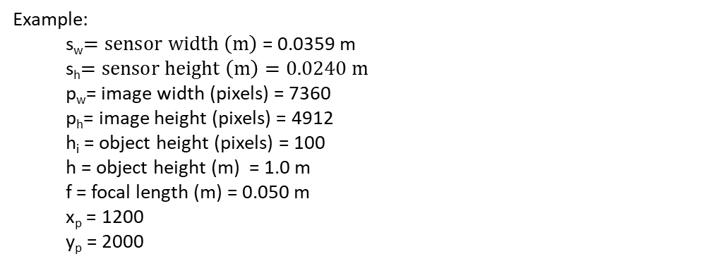



Example:
s_{w}$=sensor width \left(m\right)$ = 0.0359 m
s_{h}$=sensor height \left(m\right)=0.0240 m$
p_{w}= image width (pixels) = 7360
p_{h}= image height (pixels) = 4912
h_{i} = object height (pixels) = 100
h = object height (m) = 1.0 m
f = focal length (m) = 0.050 m
x_{p} = 1200
y_{p} = 2000
2d -> 3d Transformation
(x_{c}, y_{c}, z_{c}) = (- $\frac{s_{w}}{2}+xp$* $\frac{s_{w}}{pw}$, $\frac{s_{h}}{2}−yp$* $\frac{s_{h}}{ph}$, -f)
= (- $\frac{0.0359}{2}+1200$* $\frac{0.0359}{7360}$, $\frac{0.0240}{2}−yp$* $\frac{0.0240}{4912}$, -0.050)
= (-0.0121, 0.0022, -0.0500)
$α=$ arc tan(y_{c}/f) = 0.0445
$β=$ arc tan(x_{c}/f) = -0.2374
$$d=\frac{f∗h}{\cos\left(α\right)∗\cos\left(\text{β}\right)∗\text{h}\text{i}∗\text{s}\text{h}\text{/}\text{p}\text{h}}$$
$=\frac{0.050∗1}{\cos\left(\text{0.0445}\right)∗\cos\left(\text{−0.2374}\right)∗\text{100}∗\text{0.0240}\text{/4912}}$ = 105.39
$t=\frac{\text{105.39}}{\sqrt{{\text{−0.0121}}^{2}+{\text{0.0022}}^{2}+{\text{−0.0500}}^{2}}}$ = 2.0468e+03

Slide 27
Object location in 3d camera coordinates:
2d -> 3d Transformation
(x_{o}, y_{o}, z_{o}) = t* (x_{c}, y_{c}, z_{c})
= 2.0468e+03 * (-0.0121, 0.0022, -0.0500)
(-24.7593, 4.5602, -102.3389)
Open questions:
Derivation ok?
Assumptions ok?
Optical axis in sensor center?

Slide 28
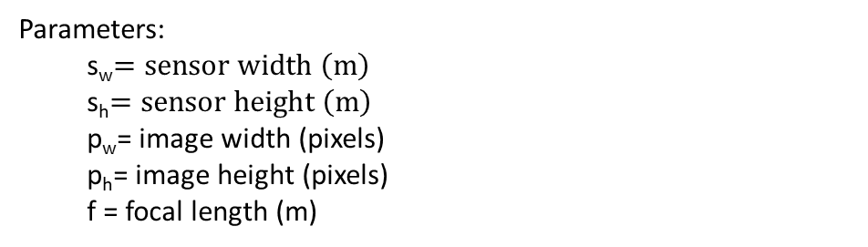
Parameters:
s_{w}$=sensor width \left(m\right)$
s_{h}$=sensor height \left(m\right)$
p_{w}= image width (pixels)
p_{h}= image height (pixels)
f = focal length (m)
2d -> 3d Transformation
Open questions:
Video metadata often lacks sensor and focal parameters
Focal length can change during shooting (zooming)

Slide 29

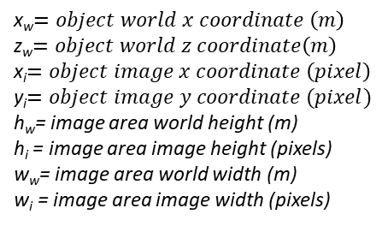


image x - coordinate
Map Presentation
object
field of view
image y – coordinate
observer
x
z
(x_{i}, y_{i}) = ( $\frac{w_{i}}{2}+x$_{w}* $\frac{w_{i}}{ww}$, $\frac{h_{i}}{2}+zw$* $\frac{hi}{hw}$)
x_{w}$=object world x coordinate \left(m\right)$
z_{w}$=object world z coordinate\left(m\right)$
x_{i}$=object image x coordinate \left(pixel\right)$
y_{i}$=object image y coordinate (pixel)$
h_{w}= image area world height (m)
h_{i} = image area image height (pixels)
w_{w}= image area world width (m)
w_{i} = image area image width (pixels)
$\frac{w_{i}}{ww}$ = $\frac{hi}{hw}$ = p (pixel/meter ratio)
(x_{i}, y_{i}) = ( $\frac{w_{i}}{2}+x$_{w}* $p$, $\frac{h_{i}}{2}+zw$*p)

Slide 30


image x - coordinate
Map Presentation
object
field of view
image y – coordinate
observer
x
z
$$FOV=2∗atan⁡(\frac{s_{w}}{2∗f})$$
s_{w}$=sensor width \left(m\right)$
f = focal length (m)

Slide 31
Before
Image World
Entity Diagram
Detected Object
Image Object
Event
Aero-
plane
Bus
Dining Table
Potted Plant
Bicycle
Car
Dog
Sheep
Bird
Cat
Horse
Sofa
Boat
Chair
Motor bike
Train
Bottle
Cow
Person
TV
Monitor

Slide 32
Entity Diagram
V2.0 goal
Detected classes not hardcoded
Object class may change
Support for many cameras , rotations
Names less awkward
Cleaning
Python style guide followed, excluding line length
Code optimization
One package
Name of the software package: ShadowWorld
(Plato: Allegory of the Cave)

Slide 33
V2.0
Entity Diagram
Presentation3D
PresentationMap
PresentationLog
…
Presentation
Speech
Synthesizer
World
Camera
”ImageObject”
”DetectedObject”
”WorldObject”
Event
Body
Pattern
Detection
Trace
Forecast
Bounding
Box

Slide 34
Camera
-----------------------
id
world
patterns
image_width
image_height
focal_length
sensor_width
sensor_height
field_of_view
x
y
z
yaw
pitch
roll
-----------------------
__init__
Pattern
-----------------------
id
camera
detections
class_id
x_min
x_max
y_min
y_max
vx_min
vx_max
vy_min
vy_max
sigma_x_min
sigma_x_max
sigma_y_min
sigma_x_max
appearance
confidence
bounding_box_color
border_left
border_right
border_top
border_bottom
retention_count
matched
----------------------
__init__
border_count
center_point
center_point_velocity
correct
Is_center_reliable
Is_vanished
location_variance
predict
set_border_behaviour
Detection
-----------------------
id
pattern
time
class_id
x_min
x_max
y_min
y_max
appearance
confidence
matched
-----------------------
__init__
pattern_distance
pattern_distance_with_class
Entities

Slide 35
World
-----------------------
bodies
cameras
speech_synthesizer
-----------------------
__init__
update
Body
-----------------------
id
world
events
traces
x
y
z
vx
vy
vz
ax
ay
az
height_min
height_mean
height_max
width_min
width_mean
width_max
length_min
length_mean
length_max
velocity_max
acceleration_max
----------------------
__init__
border_count
center_point
center_point_velocity
correct
Is_center_reliable
Is_vanished
location_variance
predict
set_border_behaviour
Event
-----------------------
body1
body2
time
category
priority
-----------------------
__init__
Entities
SpeechSynthesizer
-----------------------
engine
-----------------------
__init__
say
Trace
-----------------------
body
time
x
Y
z
-----------------------
__init__

Slide 36
Work in Progress

Slide 37
Perception
“The first step in achieving SA is to perceive the status, attributes, and dynamics of relevant elements in the environment. Thus, Level 1 SA, the most basic level of SA, involves the processes of monitoring, cue detection, and simple recognition, which lead to an awareness of multiple situational elements (objects, events, people, systems, environmental factors) and their current states (locations, conditions, modes, actions).”

Slide 38
Next Steps

Slide 39
Next steps
Comprehension:
Closing the open questions
2d -> 3d transformation
World object state estimation

Slide 40
To Be Discussed

Slide 41
To Be Discussed
Activity recognition?
Emotion recognition?
Turning camera, estimation by background movement?

Slide 42
Thank you!
lampola@student.tut.fi
https://github.com/SakariLampola/Thesis

